Slide 1
Mosquitoes and Their Diseases
Maureen Brophy, MPH
Ph.D. Student

Slide 2
Outline
What are mosquitoes?
Biology
Ecology
Mosquito Species

Slide 3
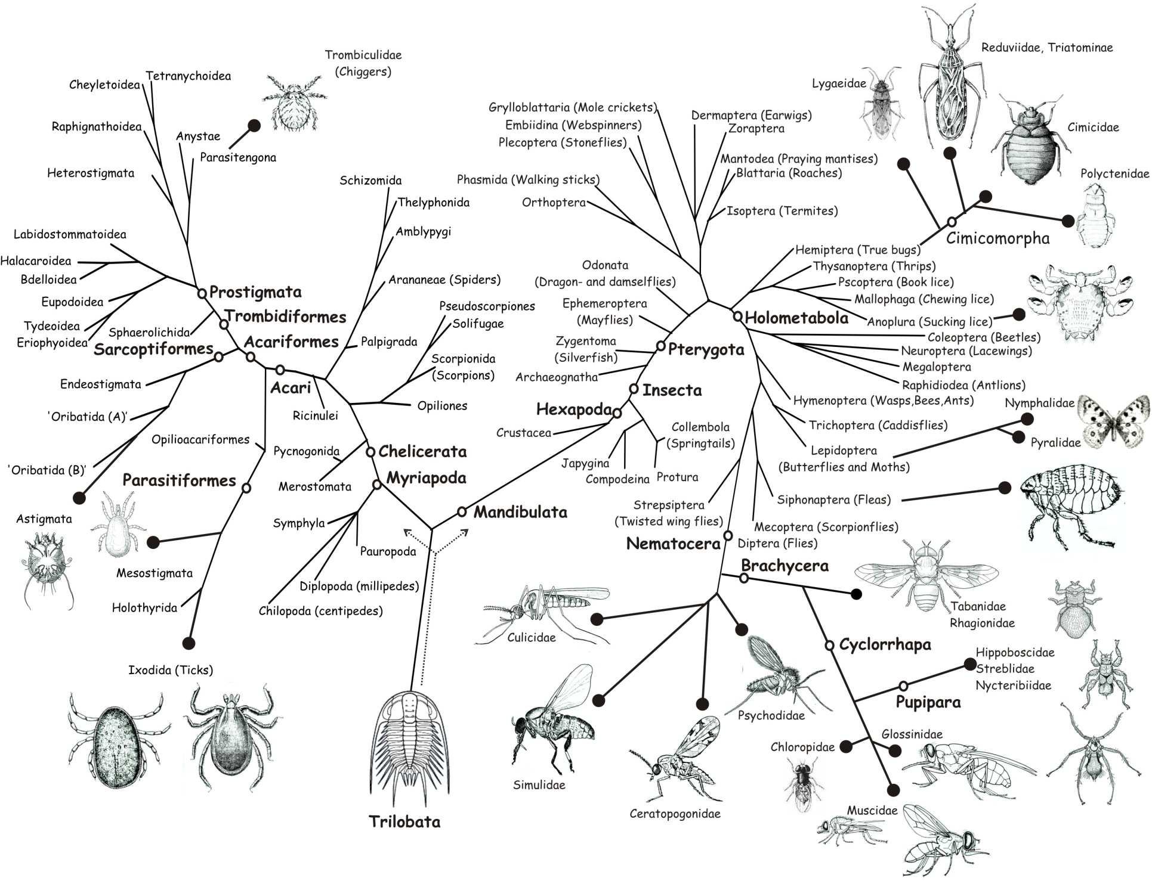
Arthropods That Feed on Vertebrate Blood

Slide 4
Biology

Slide 5
Mosquito Taxonomy
In the “Fly” order
Family Culicidae
~2,500 species worldwide
~150 species in United States
~40 species in Arizona

Slide 6
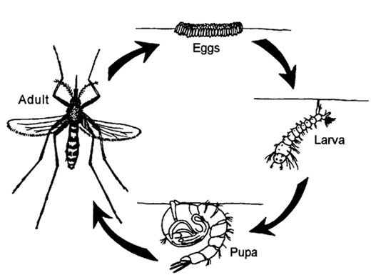
Life Cycle
Undergo complete metamorphosis

Slide 7
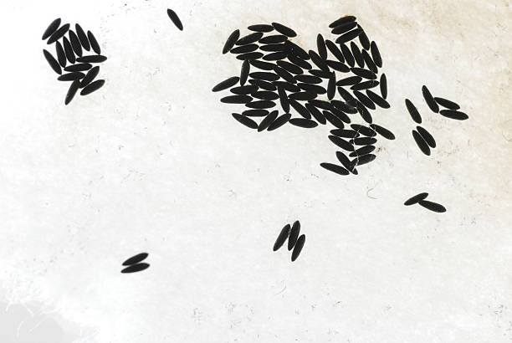
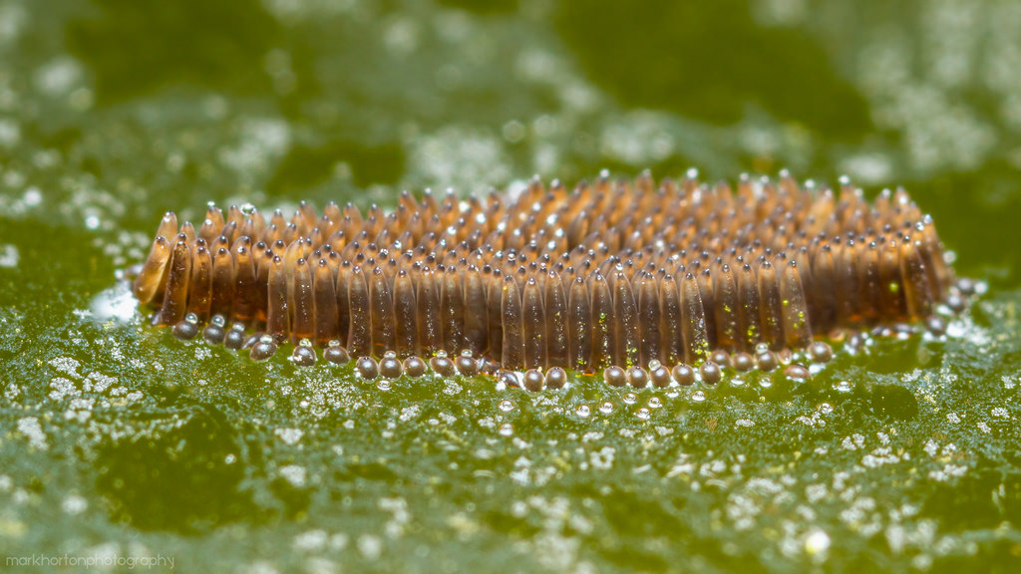
Mosquito Eggs
Depending on species, either laid individually or clumped together in a floating raft

Slide 8
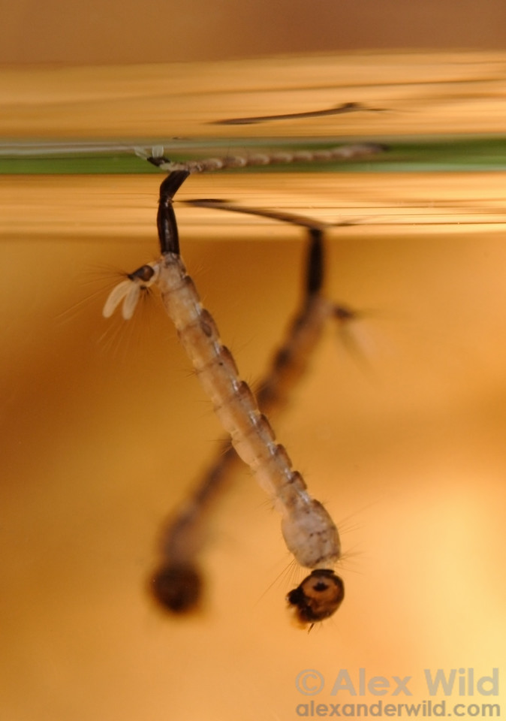
Mosquito Larvae
Aquatic
Small, white/beige
Siphon tube to breathe

Slide 9
External Biology

Slide 10
External Biology
Body
Thorax- where the wings and legs are
Abdomen- thin and elongate, fattens out after feeding

Slide 11
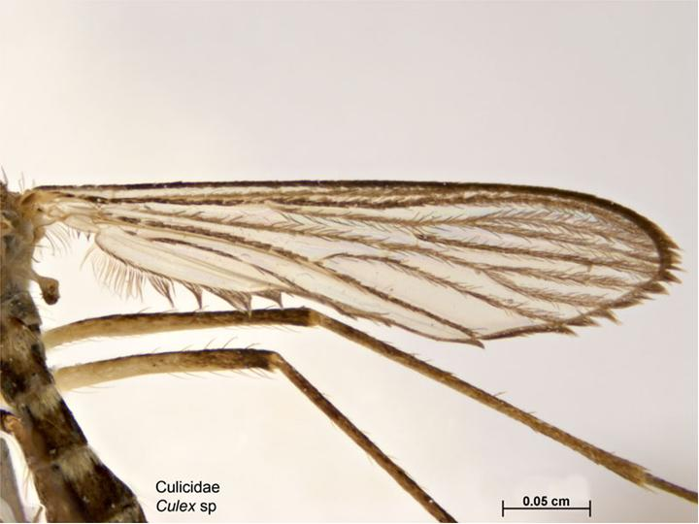
External Biology
1 set of wings
Back “wings” are tiny nubs called halteres

Slide 12
External Biology
Sensory
Antennae to “smell” and pick up chemical cues
Hairs and scales on legs and body sense heat and vibrations
Large compound eyes, but not very good at seeing

Slide 13
External Biology
Sensory
Carbon dioxide
Sweat
Lactic acid
Octenol
Temperature
Humidity

Slide 14
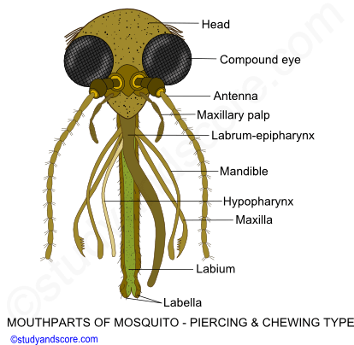
External Biology
Mouthparts- slender, made for piercing and sucking

Slide 15
Mating
Females ready to mate upon emerging from pupal stage
Males need 1-2 days for genitals to rotate
Males find females using chemical cues and wingbeat frequency
After mating, females seek host to blood feed

Slide 16
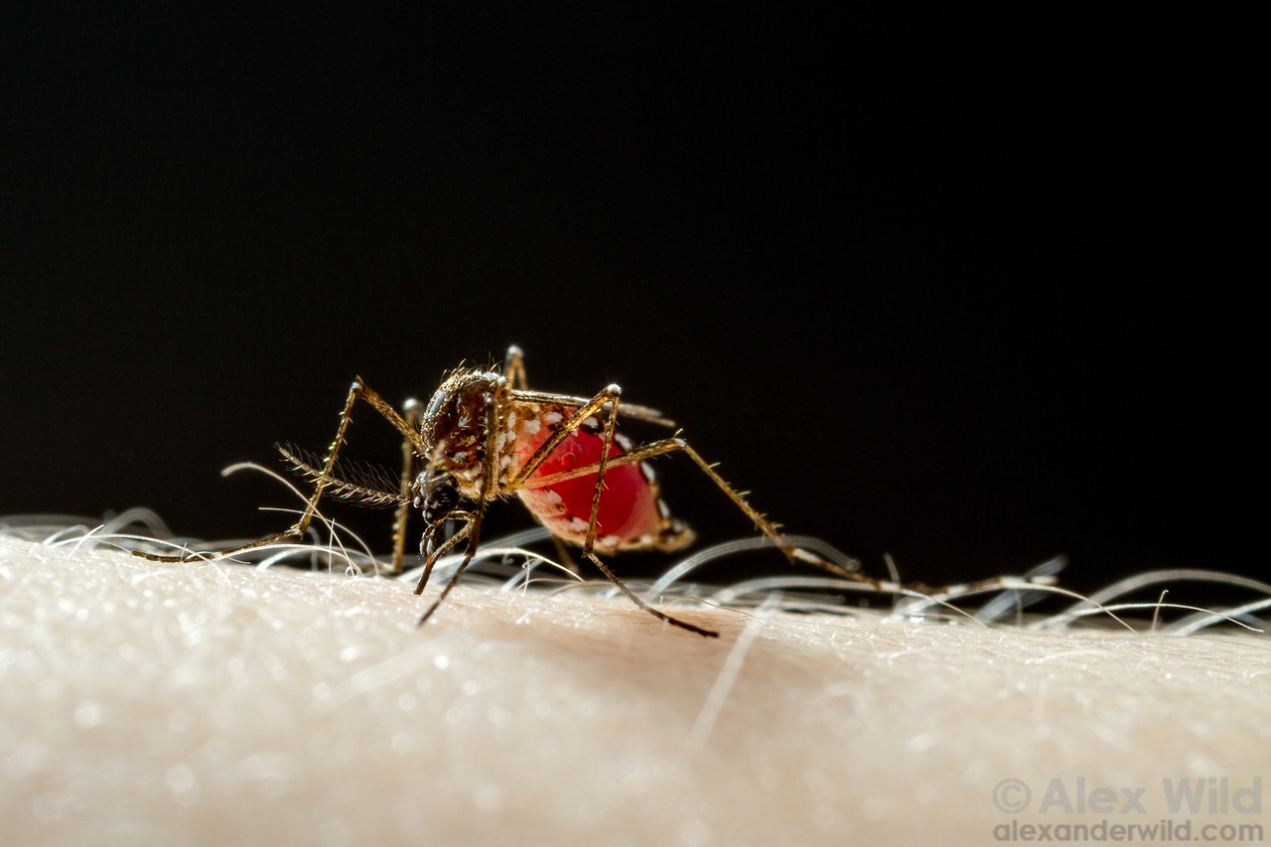
Blood Feeding
Only female mosquitoes bite
Blood meal required for reproduction

Slide 18
Blood Feeding
Solids and liquids from blood get separated in gut
Liquids get excreted during feeding, leaving room for more blood
Abdomen can stretch to accommodate meal

Slide 19
Finding a Host
Smell
Sight
Heat
Smell
Sight
Heat
Touch
Taste
Smell
Sight

Slide 20
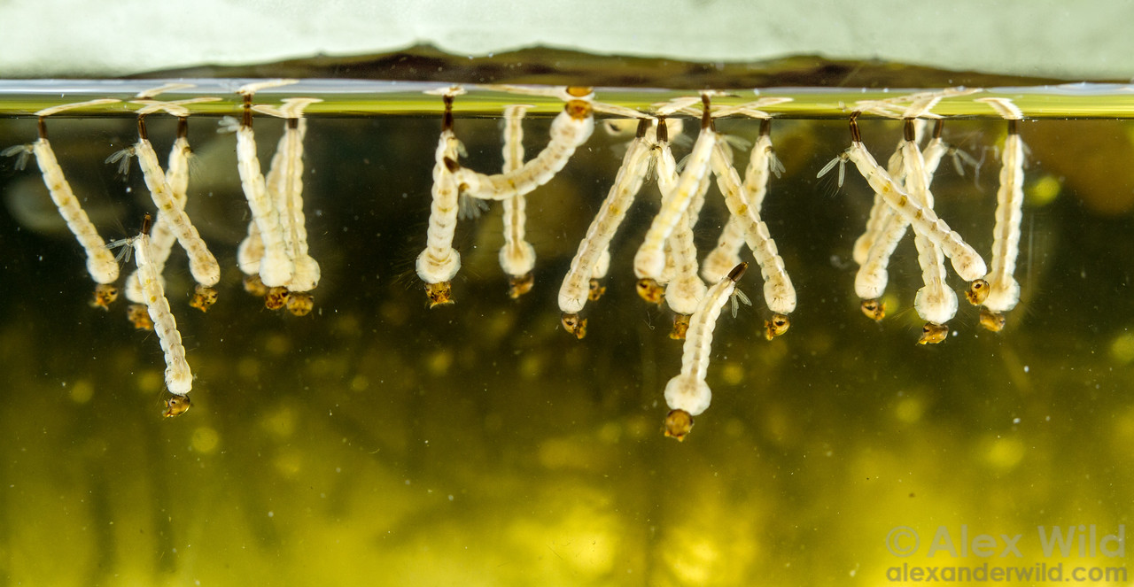
Ecology

Slide 21
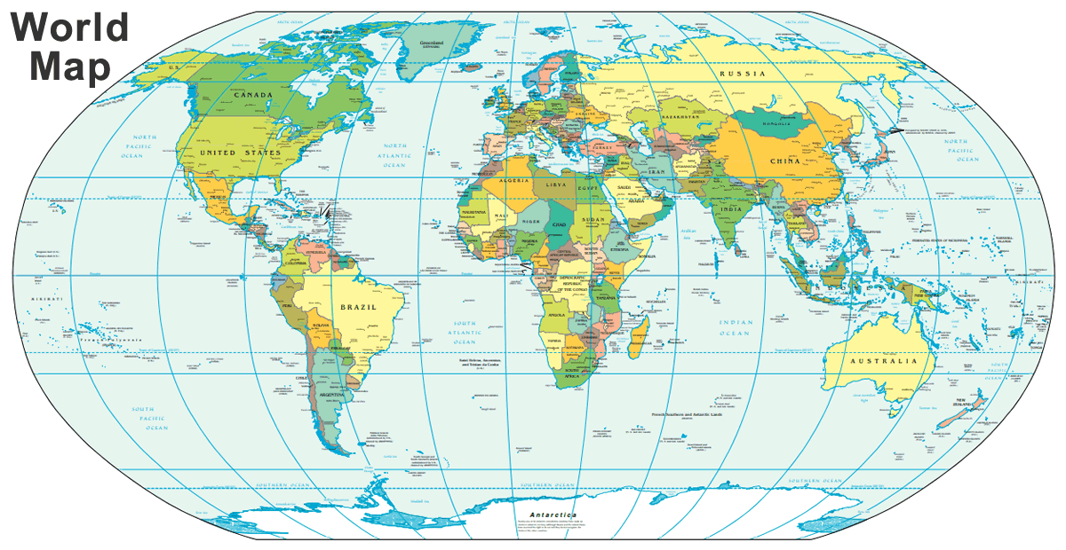
Where Are Mosquitoes Found?
On every continent except Antarctica

Slide 22
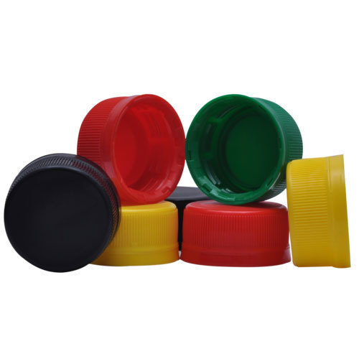
Mosquito Breeding Sites
Need standing water to lay eggs, but not much
Tree holes
Plants that collect water
Longstanding puddles
Over-irrigated landscapes
Open containers
Trash

Slide 23
Adult Survival
Adult females will live 3 weeks to 3 months, depending on conditions
Can feed and lay eggs multiple times during life
Under 50°F, adult mosquitoes will hibernate
Too cold, and they will die

Slide 24
Mosquitoes in Arizona
~40 species of mosquitoes in Arizona
Only a handful transmit disease

Slide 25
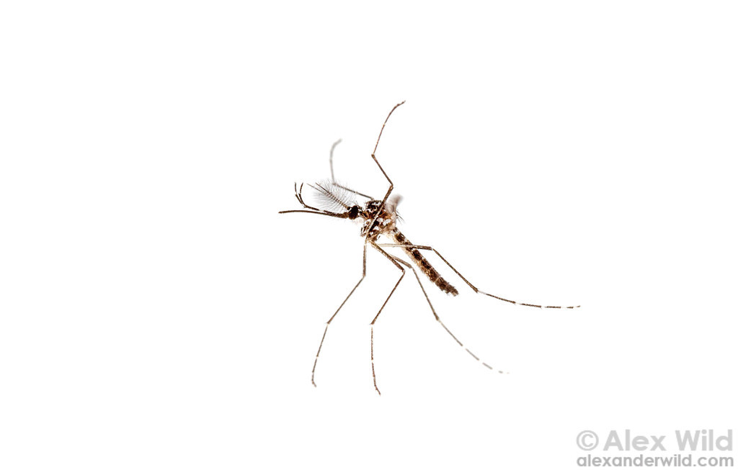
Dog Heartworm
LaCrosse Encephalitis
West Nile Virus
Zika Virus
Yellow Fever
Dengue
Chikungunya
Eastern Equine Encephalitis
St. Louis Encephalitis
Malaria
Western Equine Encephalitis

Slide 26
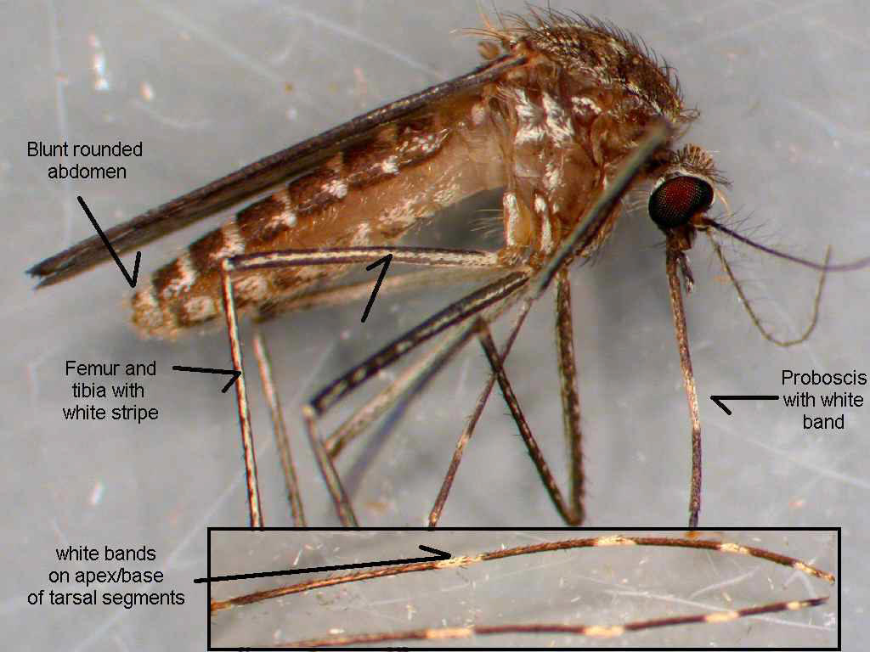
Culex Species
Notes:
AZ is home to over 40 species of mosquitoes- most of which, while annoying, don’t spread disease

Slide 27
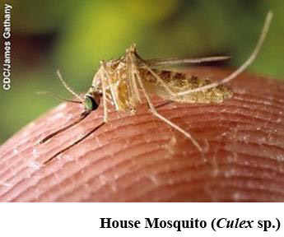
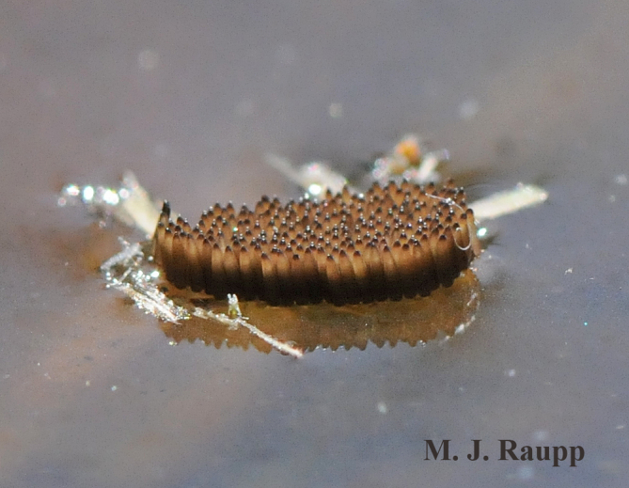
Culex Species
Transmits WNV and SLEV
Prefer to feed on birds
Live in or sewage systems, irrigated fields, man made containers
Dawn and dusk biters
Lay “raft” of eggs in still water
Can survive colder temperatures by hiding out indoors and other protected areas

Slide 28
Dog Heartworm
West Nile Virus
St. Louis Encephalitis

Slide 29
Zika Virus
Yellow Fever
Dengue
Chikungunya

Slide 30
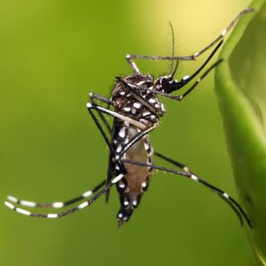
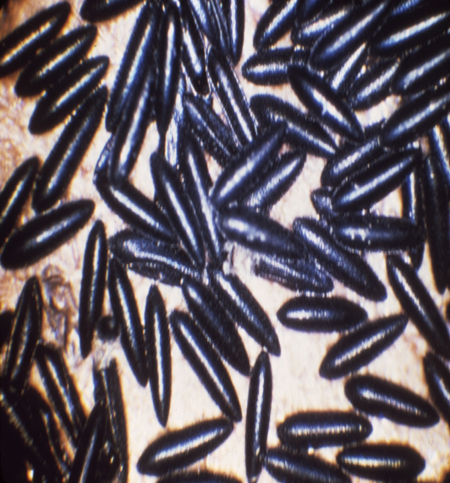
Aedes Mosquitoes
Includes many nuisance and some disease-spreading species
In AZ, are A. aegypti and A. albopictus are vectors
Can transmit Zika, dengue, and chikungunya viruses
Prefer to feed on humans
Daytime biters
Live in or near households

Slide 31
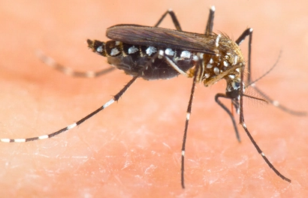
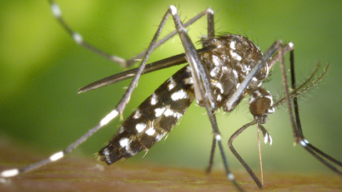
Aedes Mosquitoes
A. albopictus
Lays its eggs on flooded soil
Very aggressive
A. aegypti
Lays its eggs in containers (as small as a bottle cap)
Not very aggressive
Notes:
These two look very similar- the key difference is on their “backs” (scutum)- aegypti have lyre/harp-shaped white markings, and albopictus have a white stripe
Both daytime biters, both have short flight ranges

Slide 32
Difference Between Mosquitoes

Slide 33
Nuisance Mosquitoes
While unable to transmit disease, nuisance mosquitoes still bite humans and can cause itchy welts
Some can be very aggressive biters
Arizona has more nuisance mosquitoes than vector mosquitoes

Slide 34
Mosquito Control
Identify and remove breeding sites
Long sleeves & pants
Wear topical insect repellant
DEET, Picardin, Lemon oil of eucalyptus
Use screens in open windows & doors
Citronella does not work!

Slide 35
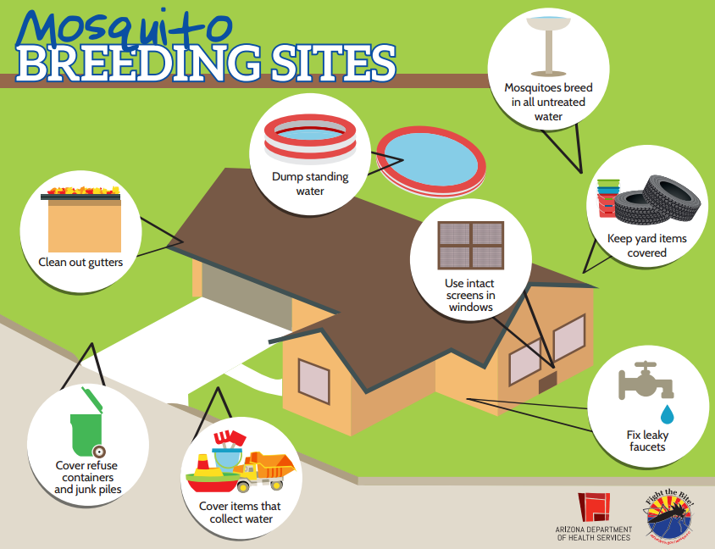
Notes:
Aedes aegypti have short flight distances. They like to stay close to their birthplace.
These mosquitos lay their eggs in standing water, both inside and outside of the home, so removing sources of water in and around your home will reduce mosquito breeding and help control the mosquito population. One of the best methods for source reduction is for residents to ensure there are no containers near the home that are uncovered and filled with water, or have the potential to hold water. Once a week, empty and scrub, turn over, cover, or throw out items that hold water, such as tires, buckets, planters, toys, pools, birdbaths, flowerpots, or trash containers. Check inside and outside your home. If you have any standing water that can’t be dumped, such as pools, ponds, etc., be sure to treat those with the appropriate chemicals. This will stop mosquitoes from laying eggs on your property.

Slide 36
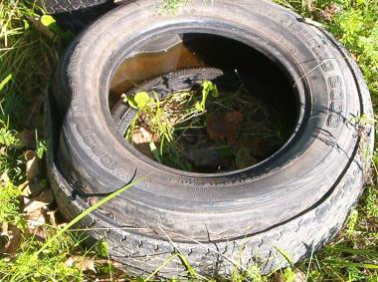
Prevention Begins at Home
Cover, turn over, throw away, or regularly clean water-holding containers

Slide 37
